Slide 1




SCORE
00
HIGH-SCORE
4000
LET'S PLAY
TANKS 1990
Akilbekov Alar SE-2116

Slide 2

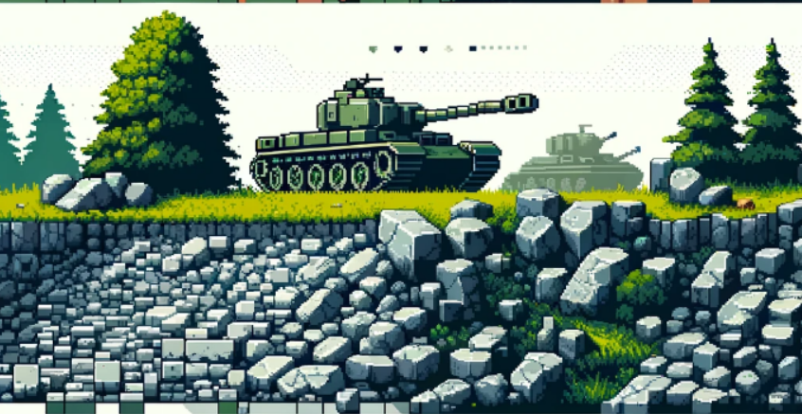

GAME CONCEPT
Players embark on a thrilling quest to reclaim their world, utilizing strategic combat and puzzle-solving skills. The game boasts an environment with AI interactions, dynamic levels, and a rich, atmospheric soundtrack that intensifies the gripping gameplay experience

Slide 3







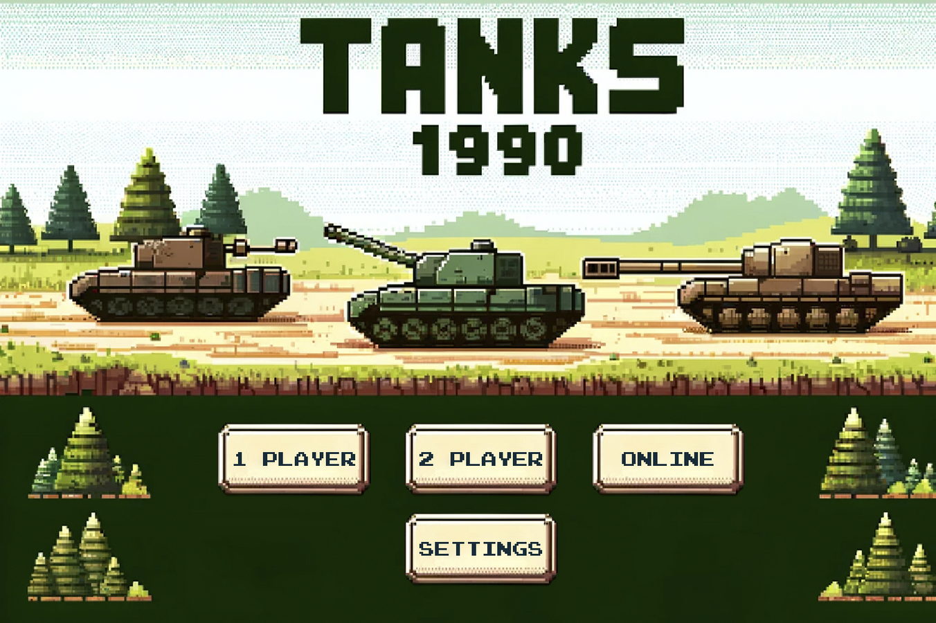







Player 1
Player 2

Slide 4



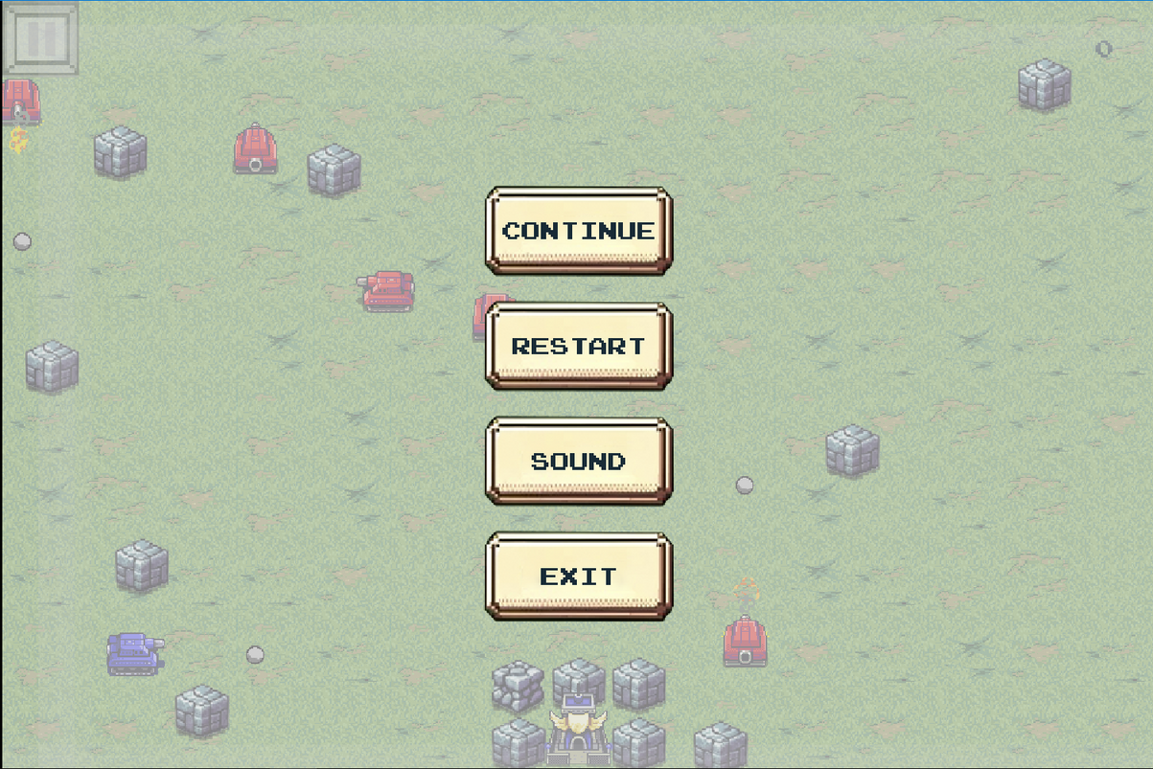
LET’S PLAY
SCORE
00
HIGH-SCORE
4000

Slide 5
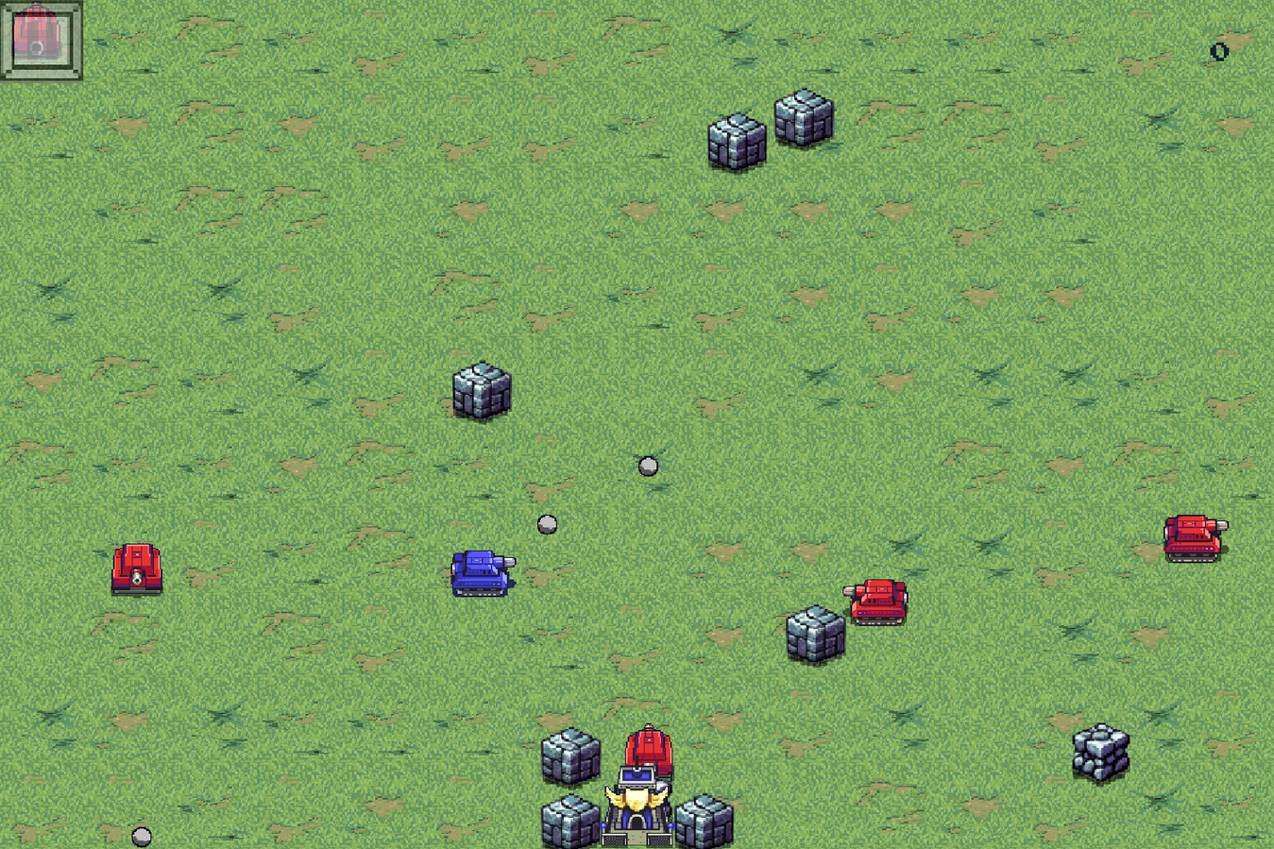
LET’S PLAY
SCORE
00
HIGH-SCORE
4000

Slide 6
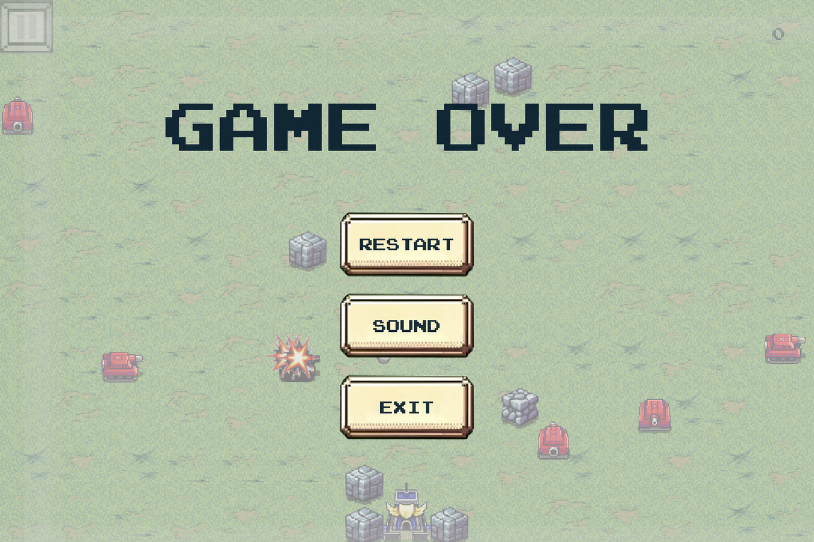
LET’S PLAY
SCORE
00
HIGH-SCORE
4000

Slide 7


MULTIPLAYER
Player 1
Player 2

Slide 8
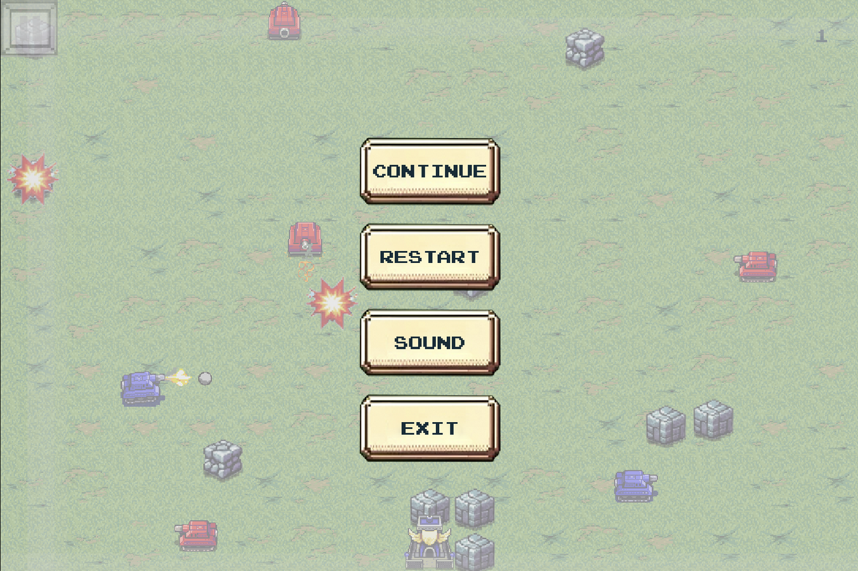
MULTIPLAYER
Player 1
Player 2

Slide 9

LibGDX Framework
Cross-platform: Supports a variety of platforms including Android, iOS, Windows, Mac and Linux.
Open Source: Free and open for modifications.
Performance: Efficient processing of graphics and animations.
Ease of Use: Easy to learn for developers with Java knowledge.
Well documented: Extensive documentation and active community.

Slide 10
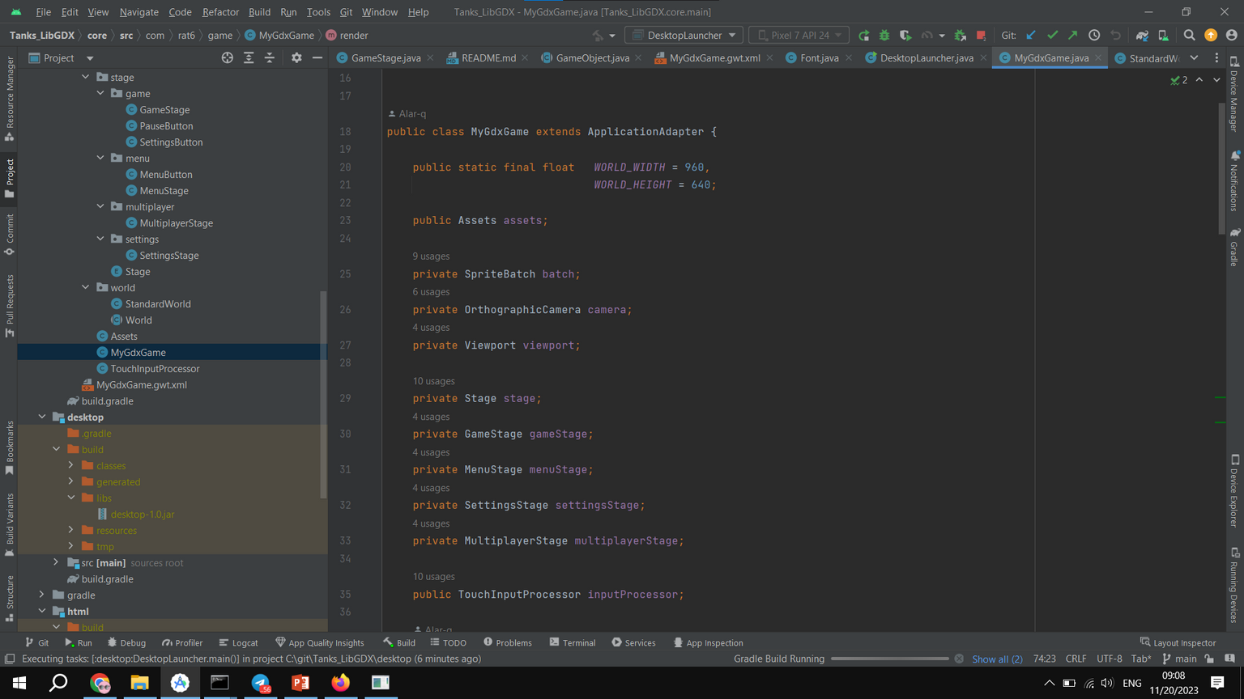
LibGDX Framework

Slide 11

CONCLUSION
In conclusion, this game is a fusion of gameplay and innovative technical features brought to life through compelling visual and sound effects. The development process has been a journey for me,,,,, and I am grateful for the opportunity to share this experience with you. Thank you for your time and consideration.

Slide 12

THANK YOU FOR PLAYING!
PLAY AGAIN?
YES
NO

